Slide 1

Bioinformatics Analysis Software Market: A Global Landscape
The bioinformatics analysis software market is undergoing rapid growth, driven by advancements in genomics, proteomics, and other life science fields. This market encompasses a wide range of software tools used to analyze and interpret biological data, enabling researchers, clinicians, and pharmaceutical companies to gain insights from complex datasets.

Slide 2
Market Overview: Key Regions and Demographics
North America
Europe
Asia-Pacific
The United States and Canada dominate the global bioinformatics market, fueled by strong research funding, a thriving biotechnology sector, and a growing focus on personalized medicine.
Europe is another major player, with countries like Germany, the UK, and France making significant investments in genomics research and healthcare technology.
The Asia-Pacific region is experiencing rapid growth, driven by increasing investments in healthcare infrastructure, expanding research institutions, and a growing demand for personalized medicine.

Slide 3

High-Potential Customer Segments
Pharmaceutical Companies
Academic Institutions
Pharmaceutical companies leverage bioinformatics software to accelerate drug discovery, develop personalized therapies, and conduct clinical trials.
Academic institutions use bioinformatics tools for research projects, teaching, and training the next generation of scientists.
Healthcare Providers
Biotechnology Companies
Healthcare providers are increasingly using bioinformatics software to diagnose diseases, personalize treatment plans, and monitor patient outcomes.
Biotechnology companies rely on bioinformatics software for research, development, and manufacturing of innovative products and therapies.

Slide 4

Market Demand Patterns and Trends
Rising Adoption of NGS
1
The increased adoption of next-generation sequencing (NGS) technologies has generated vast amounts of data, creating a demand for sophisticated bioinformatics tools.
2
Growing Demand for Personalized Medicine
The growing trend of personalized medicine requires accurate and efficient analysis of individual genetic information, driving the need for advanced bioinformatics software.
Cloud-Based Solutions Gaining Traction
3
Cloud-based bioinformatics platforms are gaining popularity due to their scalability, cost-effectiveness, and accessibility.

Slide 5




Assessing Product Features and Impact
Data Visualization
Data Integration
Data Storage and Management
Collaboration Features
The ability to visualize complex data through interactive graphs, charts, and heatmaps is crucial for interpreting results and gaining insights.
Seamless integration with other data sources, such as public databases and laboratory instruments, enables efficient workflow and data analysis.
Features that facilitate team collaboration, such as project sharing, annotation, and communication tools, are becoming increasingly important.
Secure and scalable storage solutions are essential for managing large datasets and ensuring data integrity and privacy.

Slide 6

Go-to-Market Strategy: Recommendations and Next Steps
1
Target Key Segments
2
Develop a Strong Value Proposition
Identify and prioritize specific customer segments with high growth potential, such as pharmaceutical companies, academic institutions, and healthcare providers.
Clearly articulate the unique benefits of the software, highlighting its key features, ease of use, and competitive advantages.
3
Leverage Marketing Channels
4
Build a Strong Brand Identity
Utilize a mix of marketing channels, including online advertising, content marketing, industry events, and partnerships, to reach target audiences.
Develop a consistent brand identity that resonates with the target audience, emphasizing the software's reliability, innovation, and value.

Slide 7
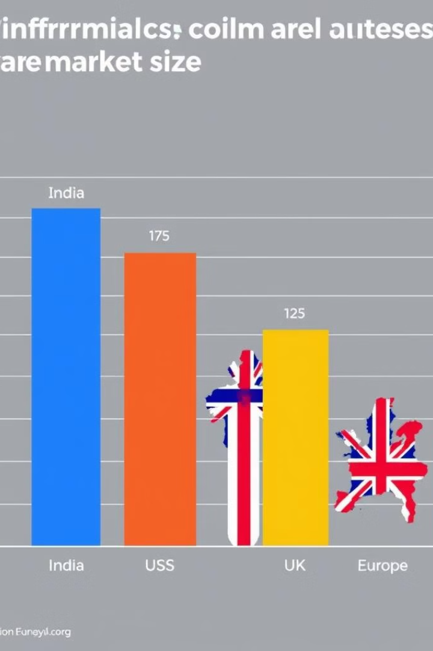
Market Size and Growth Opportunities
Region
Market Size (USD Million)
Growth Rate (%)
India
150
15-20
Middle East
80
12-18
US
500
10-15
UK
120
10-15
Europe
350
8-12

Slide 8


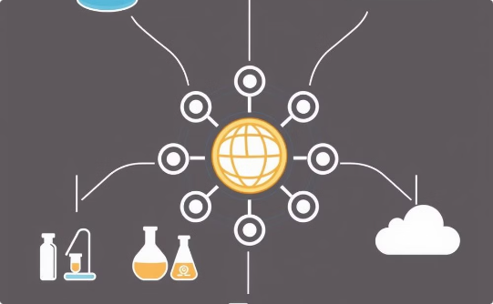
Competitive Landscape Analysis
User-Friendly Interface
Advanced Data Analysis Capabilities
Seamless Data Integration
Focus on developing a user-friendly interface that is intuitive, accessible, and caters to the needs of diverse users.
Prioritize seamless integration with other data sources and platforms to streamline workflows, improve efficiency, and minimize data duplication.
Incorporate advanced data analysis techniques, such as machine learning, statistical modeling, and predictive analytics, to provide deeper insights and support decision-making.

